Slide 1
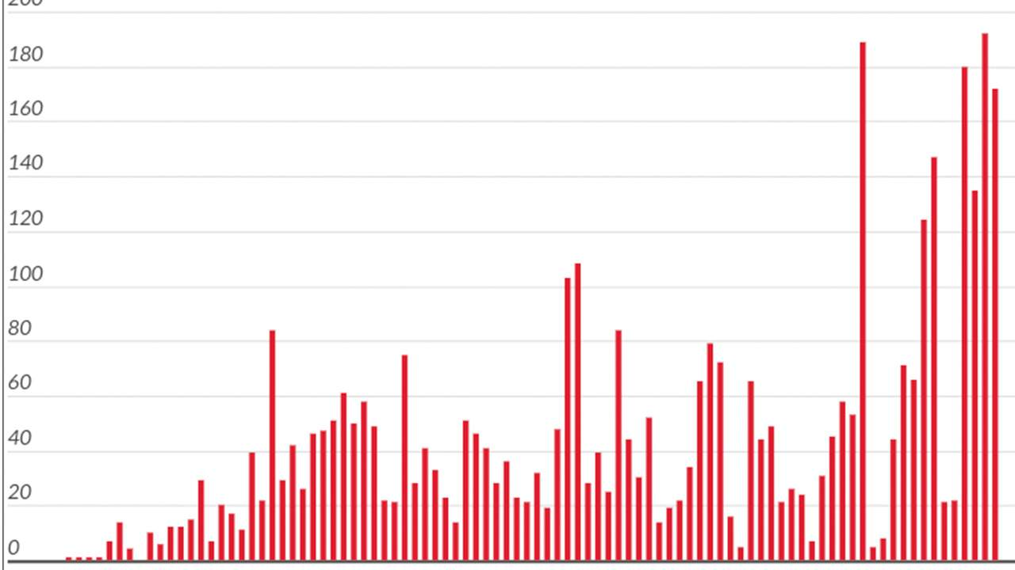
Assignment 1
COVID-19 Forecast

Slide 2
Goal
To build a machine learning model to predict the future of COIVD-19 new cases of each country
Extract and preprocess the data for model training

Slide 3
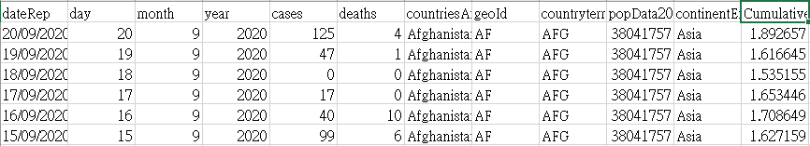
Specific Aim
To predict the cases from 10/9 to 10/15 for each country
Part of Dataset :
Download link: https://reurl.cc/q8LWap
Notice: The dataset will be updated at around 8pm everyday!

Slide 4
Assignment 1
Do it individually! Not as a team! (team is for final project)
Announce date: 2020/9/24
Deadline for prediction: 2020/10/9 11:59 am
Late work will not be accepted!
Deadline for model: 2020/10/12 23:59
No score if the model is not provided.
Hand in your homework in the following format
Prediction: Student ID
studentID_HW1.csv
studentID_HW1_Report.pdf
Model: Student ID
studentID_country
Compress them together in the .zip format

Slide 5
Grading Policy
Item | Score
Report | 30%
Model performance | 70%

Slide 6
Grading Policy of Model (70%)
You should predict cases of each country from 10/9 to 10/15 (7 days)
We will select 5 countries after the deadline to evaluate your performance
Your score will be determined by the overall performance of class

Slide 7
Report (30%)
Description of the model and features you used
Description of how to use the model file
Summarizing the works you have done
For example, I implemented regression model by myself.
For example, I used xxx package.

Slide 8
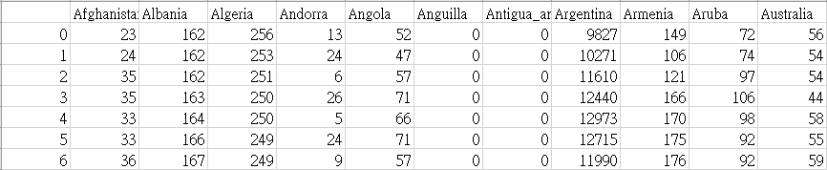
CSV format
Please submit a csv file contain 7-day prediction of all countries
There are 210 countries in the dataset, so the shape should be 7*210
For example:

Slide 9

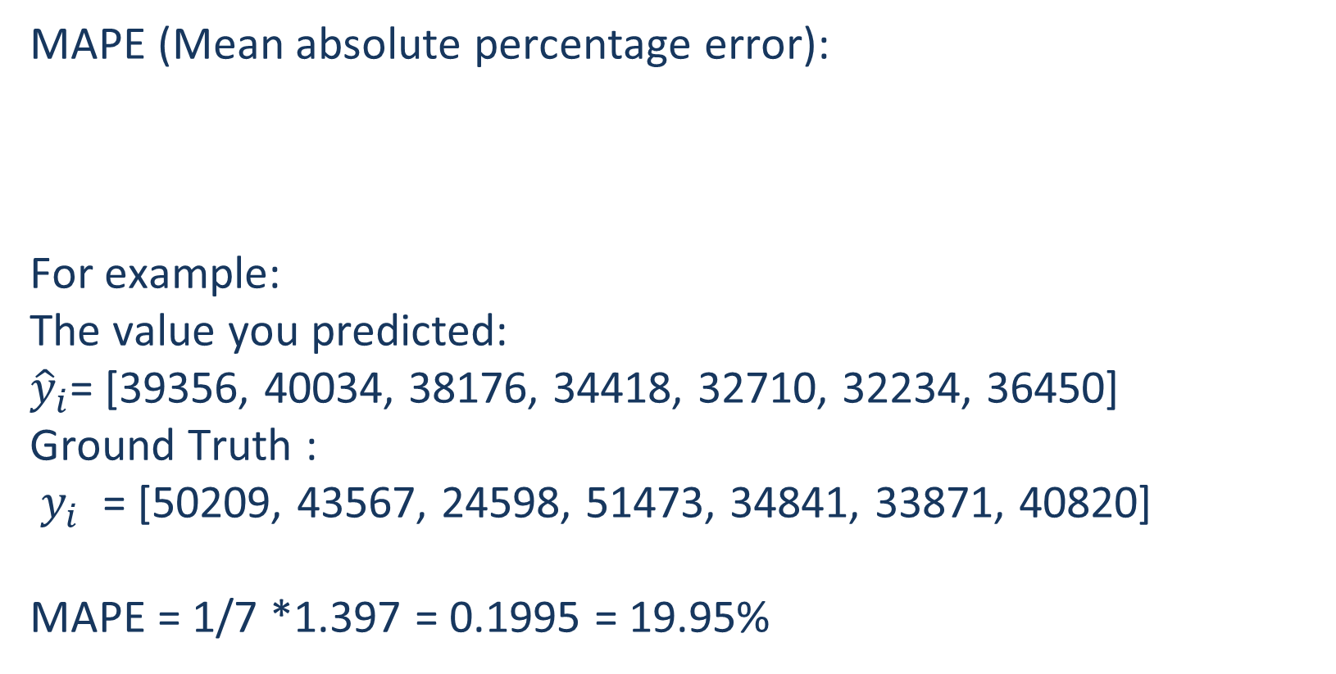
The evaluation metric
MAPE (Mean absolute percentage error):
For example:
The value you predicted:
${\hat{y}}_{i}$= [39356, 40034, 38176, 34418, 32710, 32234, 36450]
Ground Truth :
$y_{i}$ = [50209, 43567, 24598, 51473, 34841, 33871, 40820]
MAPE = 1/7 *1.397 = 0.1995 = 19.95%

Slide 10

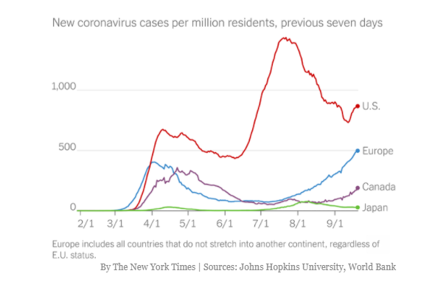
Have fun!

